Slide 1
AirBnB Toronto Data Analysis
An attempt to find if and how weather and crime are related

Slide 2
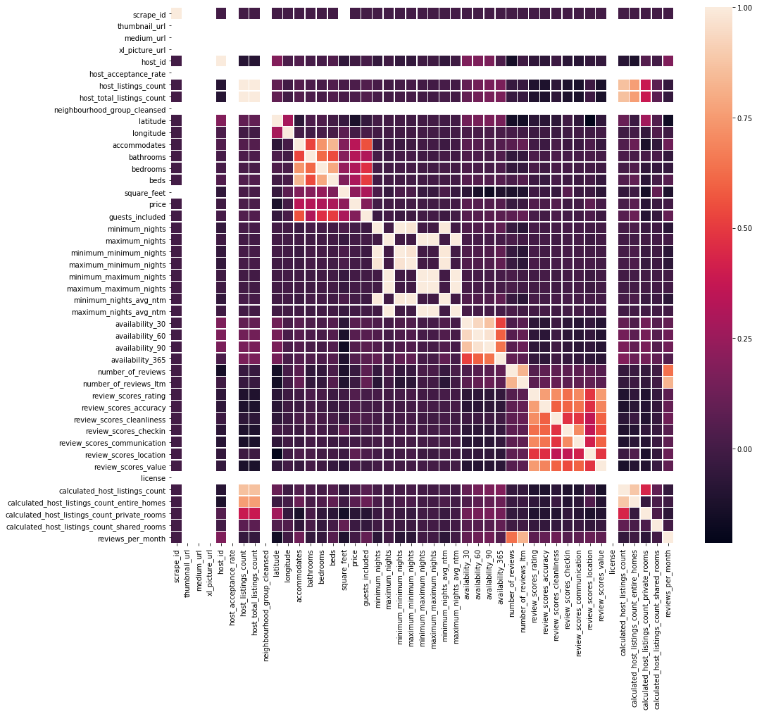
AirBnB Toronto Data Analysis Correlation Matrix – All Attributes

Slide 3
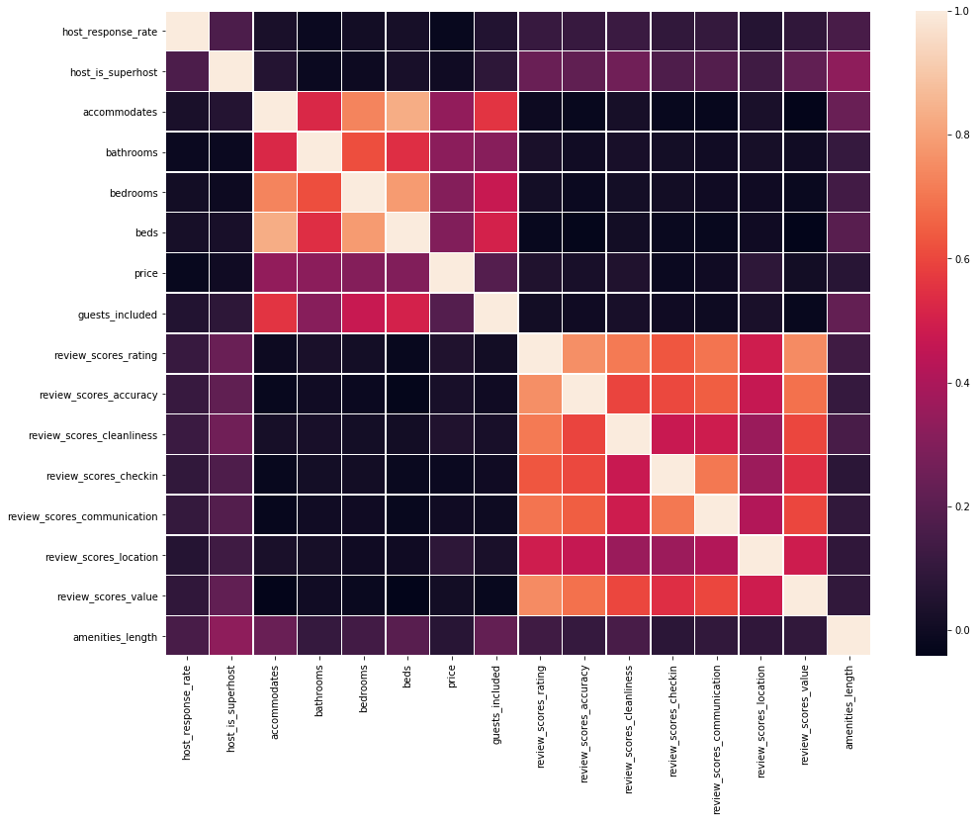
AirBnB Toronto Data Analysis Correlation Matrix – Selected Attributes

Slide 4
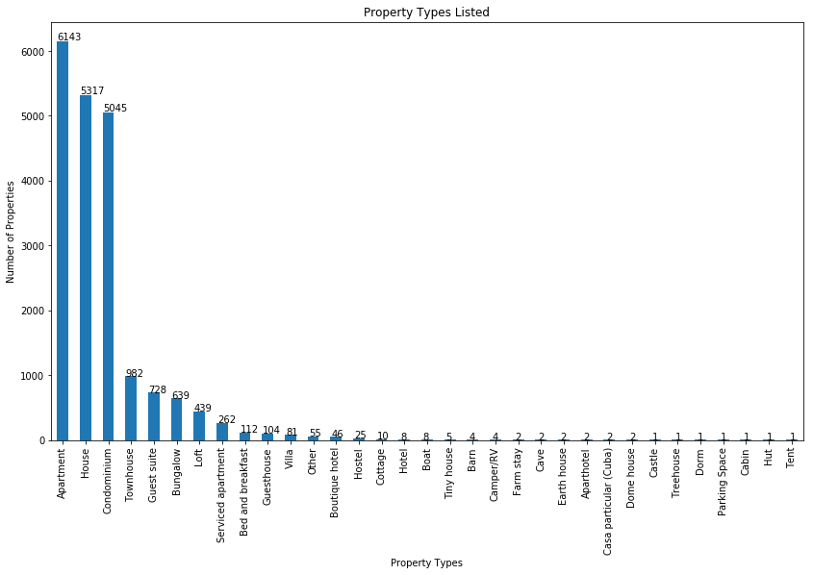
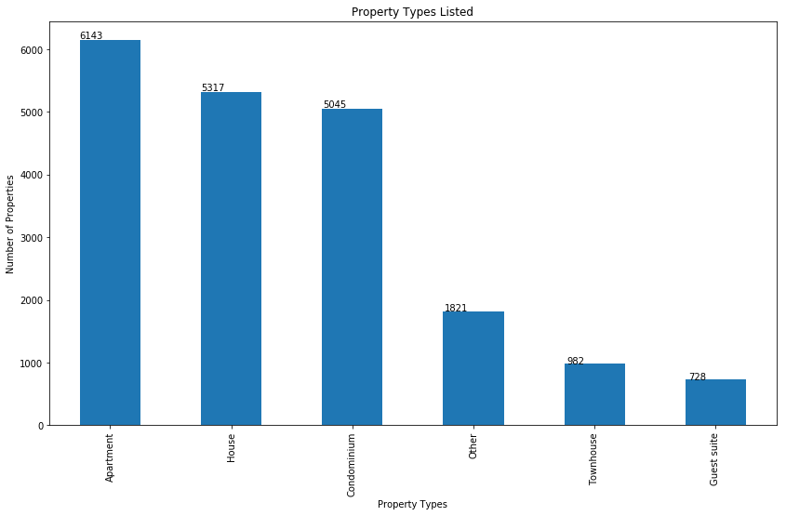
AirBnB Toronto Data Analysis Property types listed

Slide 5
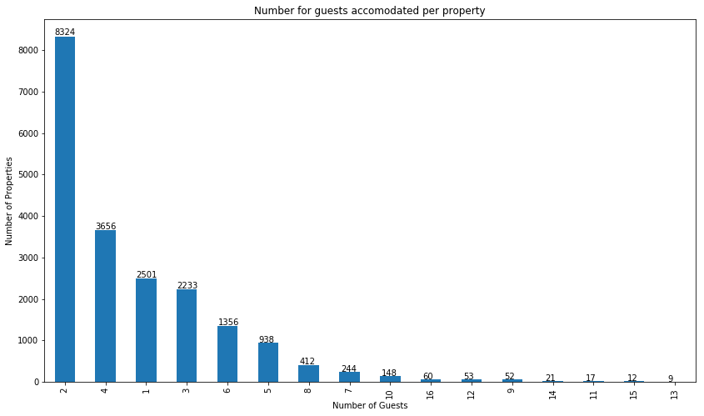
AirBnB Toronto Data Analysis Guests allowed per property

Slide 6
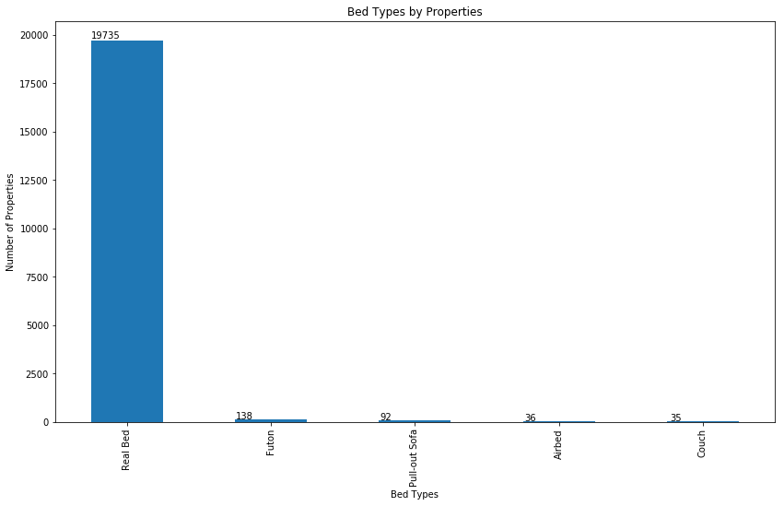
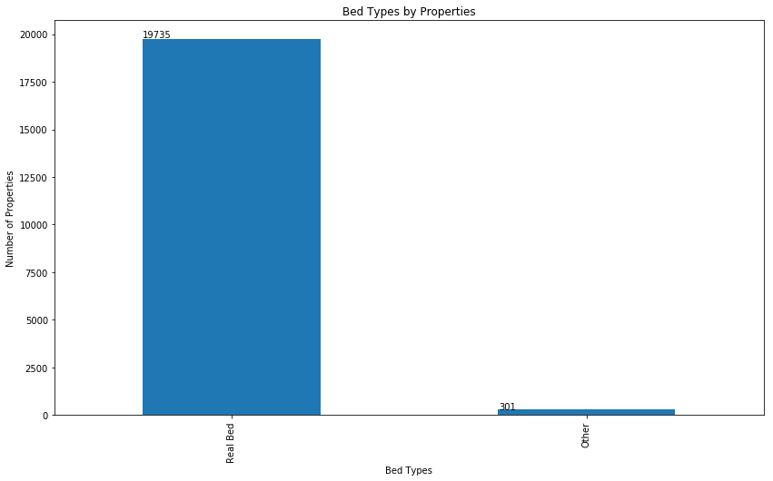
AirBnB Toronto Data Analysis Bed types listed

Slide 7
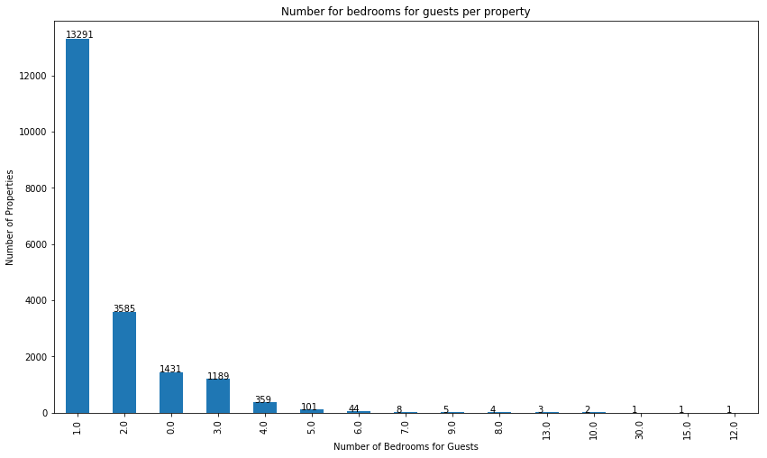
AirBnB Toronto Data Analysis Number of bedrooms

Slide 8
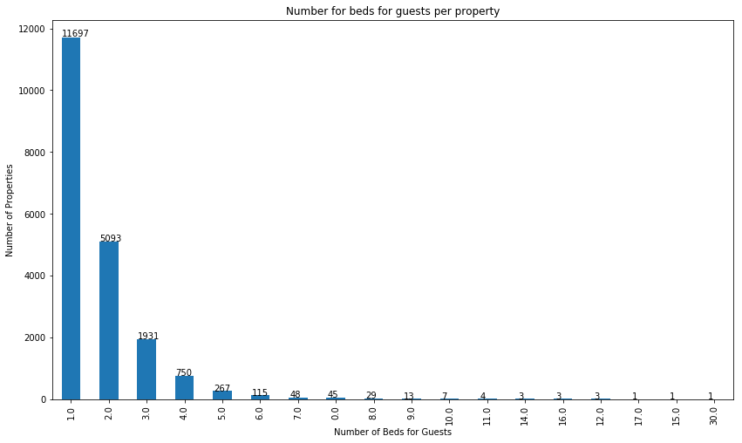
AirBnB Toronto Data Analysis Number of beds for guests per property

Slide 9
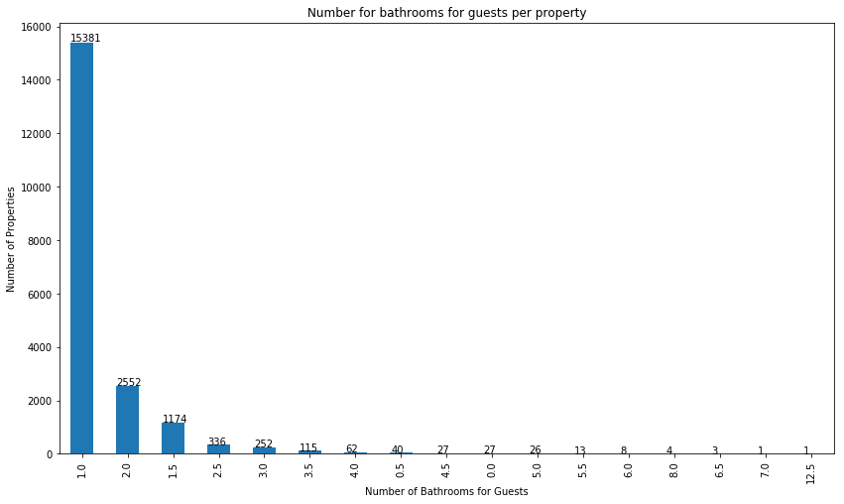
AirBnB Toronto Data Analysis Number of bathrooms for guests per property

Slide 10
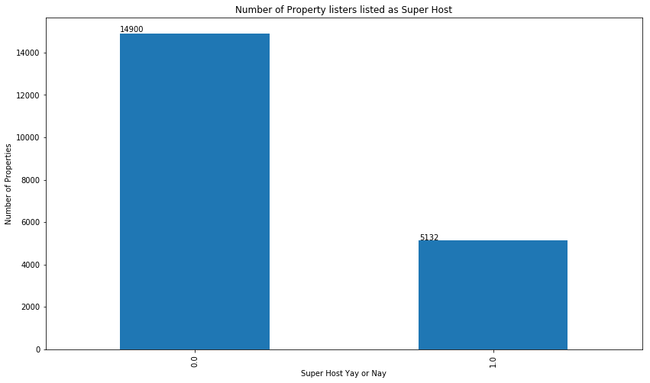
AirBnB Toronto Data Analysis Number of hosts listed as super hosts

